Slide 1
스승의 은혜
Made By 12그룹

Slide 2
INDEX.
1
2
3
4
기획설명
서버 시연
웹시연
게임시연

Slide 3
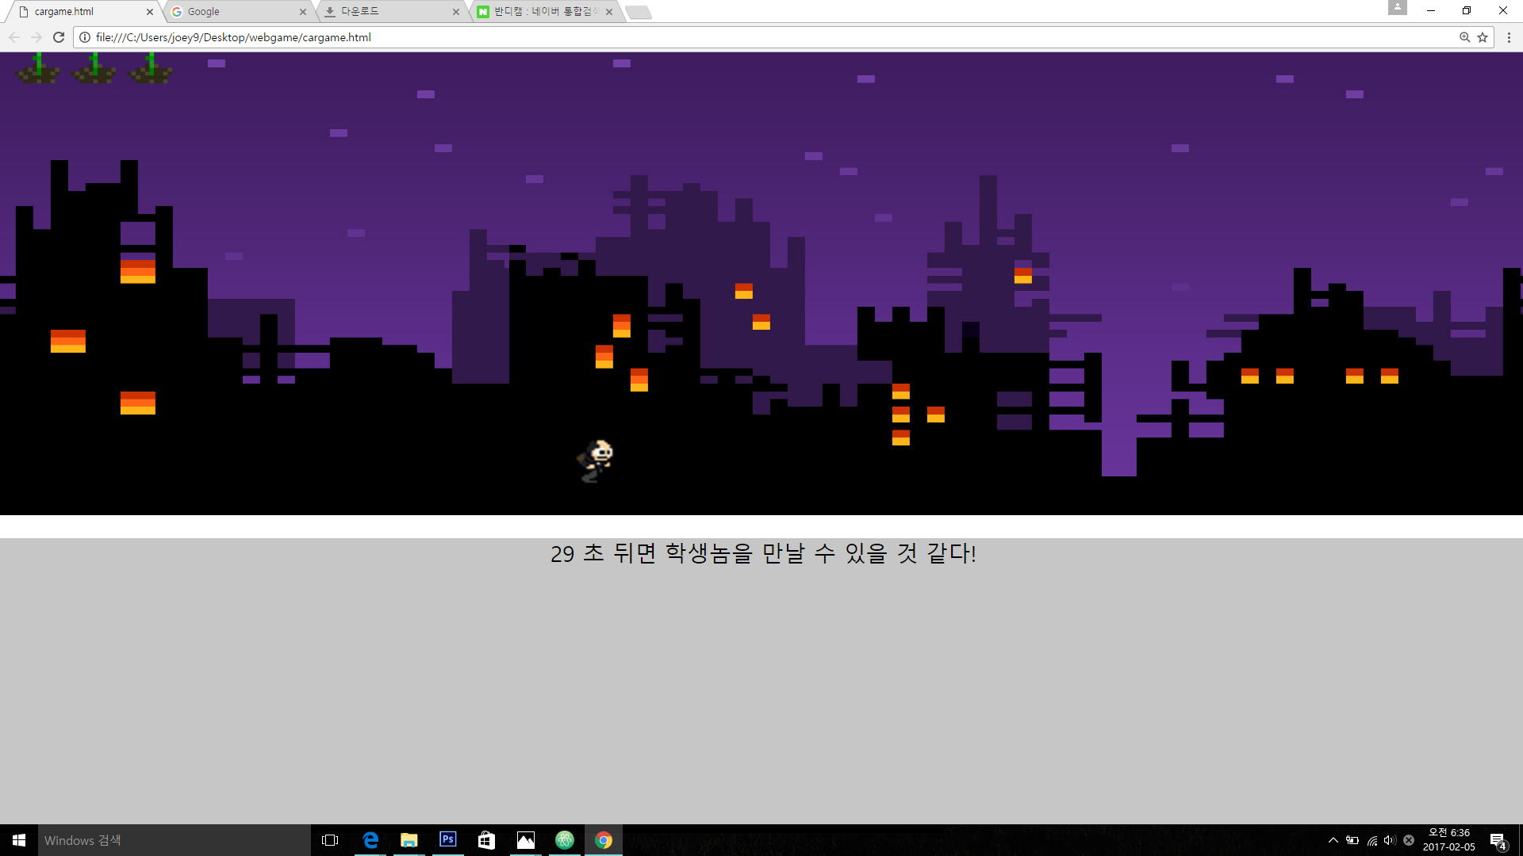
18 MINUTES / DAY
AVG. TIME SPENT
ON FACEBOOK
1,230,000,000
USERS
350 MILLION
PHOTOS UPLOADED
EVERY DAY

Slide 4
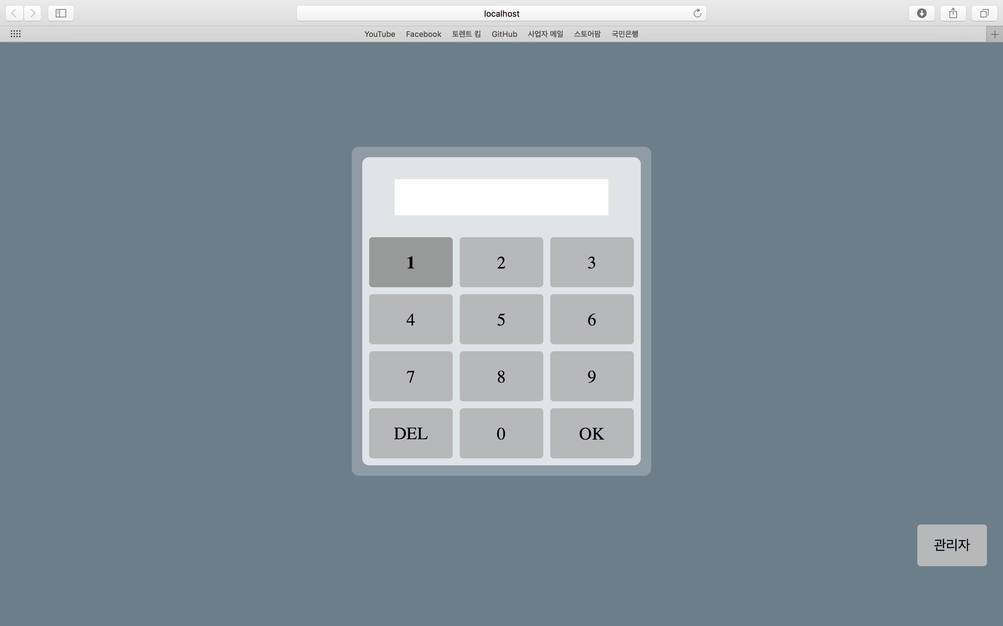
18 MINUTES / DAY
AVG. TIME SPENT
ON FACEBOOK
1,230,000,000
USERS
350 MILLION
PHOTOS UPLOADED
EVERY DAY

Slide 5
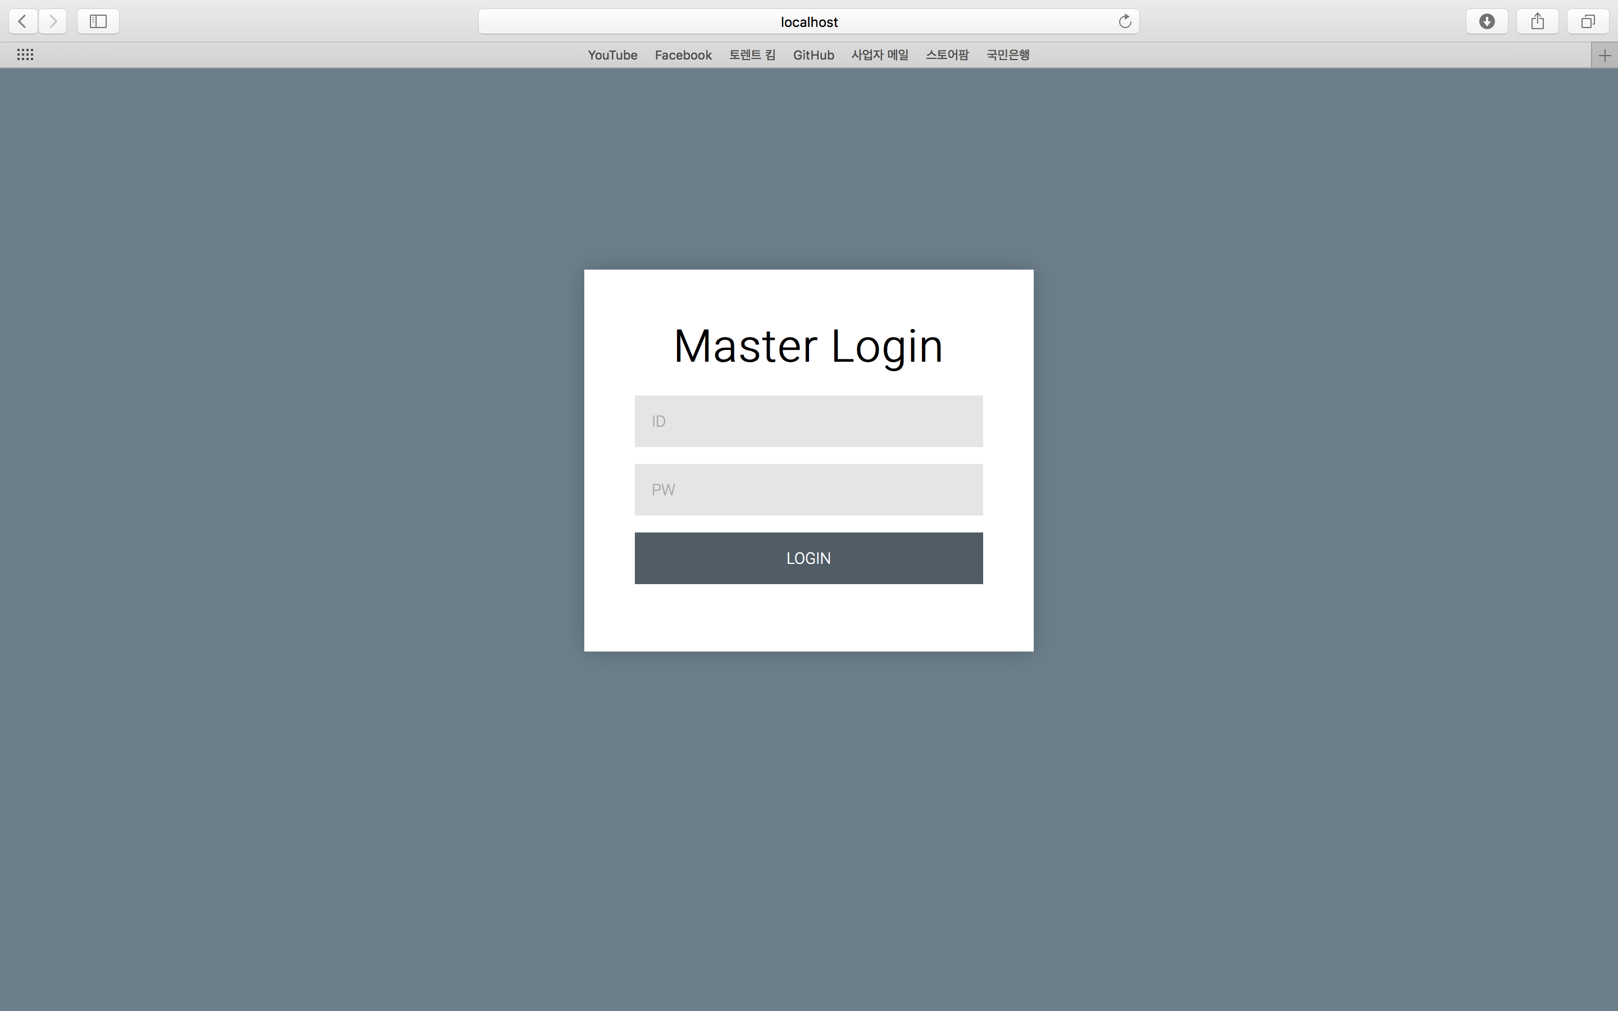
18 MINUTES / DAY
AVG. TIME SPENT
ON FACEBOOK
1,230,000,000
USERS
350 MILLION
PHOTOS UPLOADED
EVERY DAY

Slide 6
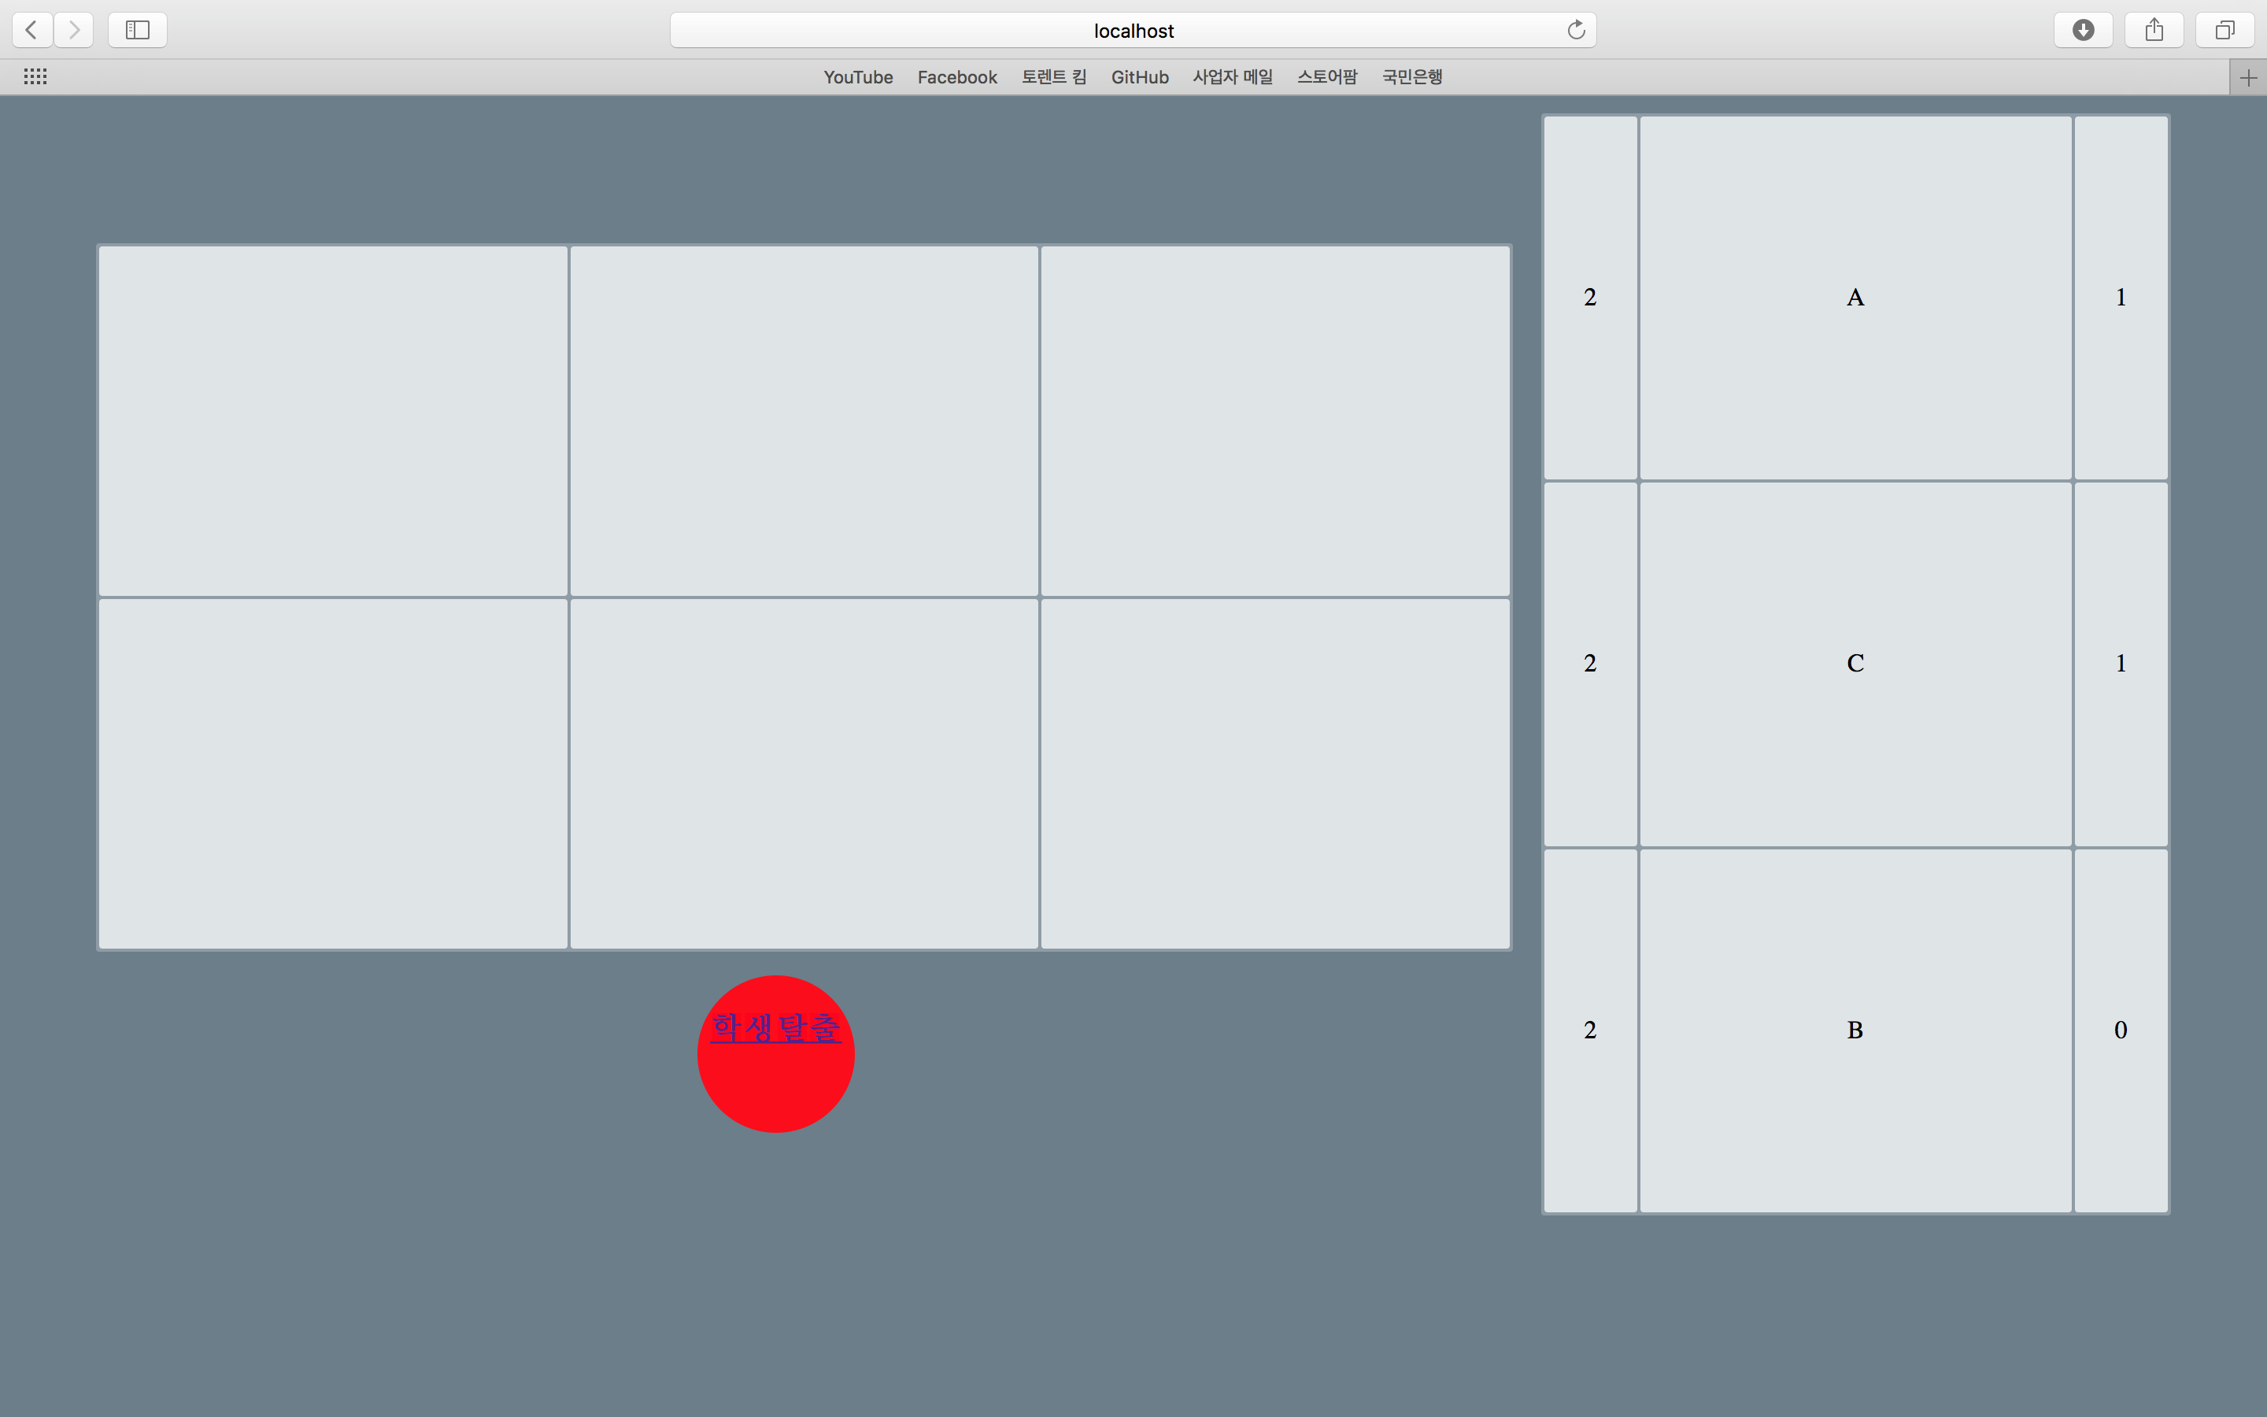
18 MINUTES / DAY
AVG. TIME SPENT
ON FACEBOOK
1,230,000,000
USERS
350 MILLION
PHOTOS UPLOADED
EVERY DAY

Slide 7
https://github.com/D3S-Hackathon-12/D3S_Backend

Slide 8
감사합니다.
12그룹

